Slide 1

Movie Recommendation System
PRESENTED BY: ANOOSH GUDDEHITHLU PRATHAP KUMAR (801200789)

Slide 2
Problem and Challenges
Movie Recommendation System recommends movies similar to the movie user likes and reviews given by the user for that movie.
This dataset (ml-latest-small) describes 5-star rating and free-text tagging activity from [MovieLens], It contains 100836 ratings and 3683 tag applications across 9742 movies. https://grouplens.org/datasets/movielens/
The data are contained in the files `links.csv`, `movies.csv`, `ratings.csv` and `tags.csv`.
Users were selected at random for inclusion, and each user selected rated at least 20 movies.
One challenge I would mention is, the data set may contain vast number of movies, but not all, that too not in all languages. But to achieve that it takes large amount of datasets, processing power, computational tasks and cost.

Slide 3
Motivation
◆ On the Internet, the number of choices are huge, there is a need to filter, order and proficiently deliver related information in order to improve the problem of surplus information, which has created a problem to many Internet users.
◆ Recommendation System solve this problem by searching through huge volume of dynamically generated information to offer the users with modified content.
◆ Similarly when we talk about Entertainment, movies comes to our mind. There are thousands of movies in the Internet from decades and still counting. Users gets confused what to watch, so based on user rating, genres, preferences and etc. it is beneficial to build a Movie Recommendation System.

Slide 4
Existing Work
◆ Title: Movie Recommendation System using Cosine Similarity and KNN
◆ Authors: Ramni Harbir Singh, Sargam Maurya, Tanisha Tripathi, Tushar Narula, Gaurav Srivastav
◆ Year: June 2020
◆ Publication: International Journal of Engineering and Advanced Technology (IJEAT), ISSN: 2249 – 8958 (Online), Volume-9 Issue-5, June 2020
This paper describes an approach which offers generalized recommendations to every user, based on movie popularity and/or genre. Content-Based Recommender System is implemented using various deep learning approaches. This paper also gives an insight into problems which are faced in content-based recommendation system.

Slide 5
Comprehensive Movie Recommendation System
◆ Authors: Hrisav Bhowmick, Ananda Chatterjee, Jaydip Sen.
◆ Year: 23 Dec 2021
◆ Publication: arXiv:2112.12463 [cs.IR]
◆ Paper Title: Comprehensive Movie Recommendation System, 23rd Dec
2021, Hrisav Bhowmick, Ananda Chatterjee, Jaydip Sen.
arXiv:2112.12463 [cs.IR]

Slide 6
Contd..
◆ A recommender system, also known as a recommendation system, is a type of information filtering system that attempts to forecast a user's rating or preference for an item.
◆ Movie Recommendation System prototype based on the Genre, Pearson Correlation Coefficient, Cosine Similarity, KNN-Based, Content-Based Filtering using TFIDF and SVD, Collaborative Filtering using TFIDF and SVD, Surprise Library based recommendation system technology.
◆ Dataset: Movie Lens dataset from group lens website which contains 100836 ratings and 3683 tag applications across 9742 movies. These data were created by 610 users between March 29, 1996, and September 24, 2018.

Slide 7
Contd..
◆ Title: Personalize Movie Recommendation System
◆ Authors: Shujia Liang, Lily Liu, Tianyi Liu
◆ Year: December 4, 2018
◆ Publication: Personalize Movie Recommendation System CS 229 Project Final Writeup
https://www.semanticscholar.org/paper/Personalize-Movie-Recommendation-System-CS-229- Liang-Liu/f6cec17b04453d0403c281006352581dc996f439. Corpus ID: 145035080
Current recommender systems generally fall into two categories: content-based filtering and collaborative filtering. The paper explains both approaches. Content-based filtering, uses movie features such as actors, directors, movie description, and keywords as inputs and TF-IDF and doc2vec to calculate the similarity between movies. Collaborative filtering uses ‘observed users’ movie rating as input and also use K-nearest neighbors and matrix factorization to
predict user’s movie ratings. When comparing collaborative filtering seems to perform better
than content-based filtering in terms of prediction error and computation time.
Dataset: MovieLens

Slide 8
My Work and Implementation
Prior versions of MovieLens dataset consists of precomputed cross-folds or scripts
to perform this task, but we don’t use either of these features in our dataset.
User Ids and Movie Ids
Ratings Data file Structure, Tags Data file structure, Movies data file structure and links data file structure.
Genres included: * Action* Adventure* Animation* Children's* Comedy* Crime* Documentary*Drama* Fantasy*Film-Noir* Horror* Musical* Mystery* Romance* Sci-Fi*Thriller* War* Western* (no genres listed)
Usage
Works with any case (lower or upper)
The word "the" is always ignored
You can put the year of the movie inside brackets like: (2020)

Slide 9
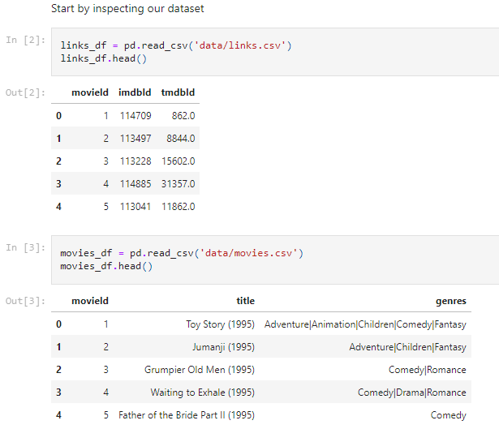
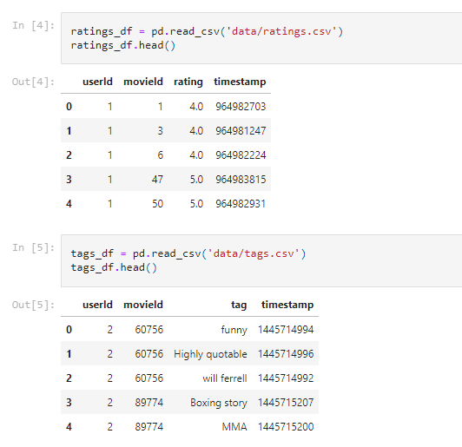
Start by inspecting our dataset

Slide 10
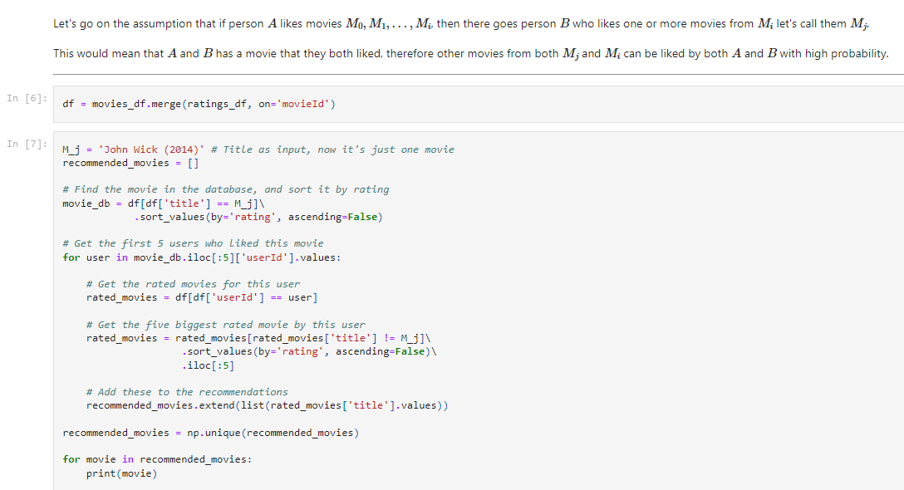
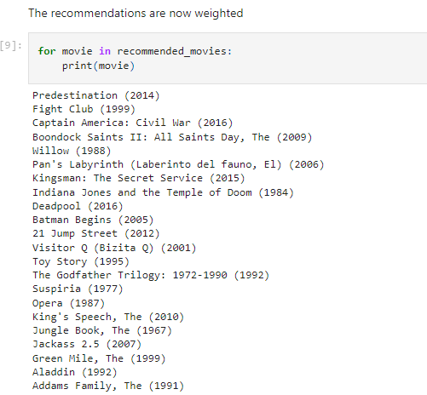

Slide 11
Steps involved
Loading the needed data
Check for the movie name in the database
Exclude "the“
Find the most similars by name.
Do not add movie to the list if it has already
been added
Choose the biggest pointed five
Ask user for input
Find the movie in the database, and sort it by rating
Get the five biggest rated movie by this user
Add these to the recommendations

Slide 12
Result and Future work
The model could successfully recommends list of movies similar to those based on user input and reviews
The future work would be, building front-end using JavaScript and make it web based application using APIs.

Slide 13
More References
https://github.com/
https://arxiv.org/
https://grouplens.org/datasets/movielens/
https://doi.org/10.1145/2827872
◆ Papers: References [1] M J. Pazzani, D. Billsus, “Content-Based Recommendation,” The
Adaptive Web Springer Link, vol. 4321, pp.325–341
◆ [2] G. Suganeshwari, and S. P. Ibrahim, “A Survey on Collaborative Filtering Based
Recommendation System,” Proceedings of the 3rd International Symposium on Big Data
and Cloud Computing Challenges (ISBCC – 16’), vol. 49, pp. 503-518, February 2016.
◆ [3] Z. Wang, X. Yu, N. Feng, Z. Wang, “An improved collaborative movie recommendation system using computational intelligence,” Journal of Visual Languages & Computing, vol. 25, pp. 667-675, December 2014.

Slide 14
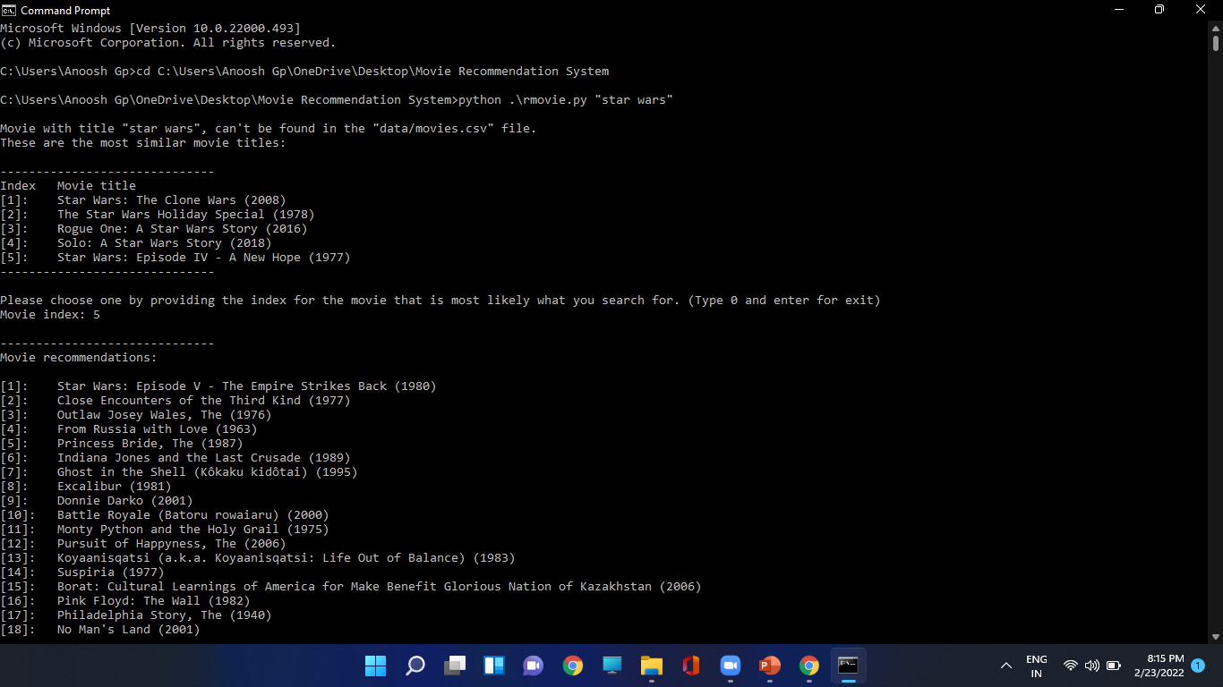

Slide 15
Thank You

